Slide 1
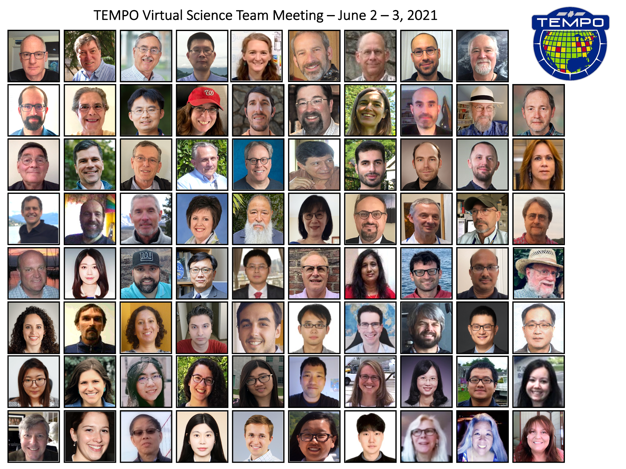

Status of TEMPO
(Tropospheric Emissions: Monitoring of Pollution)
Kelly Chance
on behalf of The TEMPO Team
Center for Astrophysics | Harvard & Smithsonian
kchance@cfa.harvard.edu
The 13th International GEMS Workshop
November 11, 2022

Slide 2

Hourly daytime atmospheric pollution over North America from the GEO
NASA’s first Earth Venture Instrument (EVI) selected in 2012 & first host payload
PI: Kelly Chance, SAO: STM, ground systems, science data processing center
Instrument Development: Ball Aerospace
Instrument Project Management: NASA LaRC, PM: Kevin Daugherty
Other Institutions: NASA GSFC, NOAA, EPA, NCAR, Harvard, UC Berkeley, St. Louis U, UAH, U Nebraska, Sitting Bull College, RT Solutions, Carr Astronautics
International collaboration: Mexico, Canada, Cuba, Korea, U.K., ESA, Spain
Mission Project Management: NASA LaRC, current PM: Kevin Daugherty
Host Satellite Provider: Maxar Technologies
Satellite Host: Intelsat (IS-40e)
Launch: SpaceX
Provides hourly daylight observations to capture rapidly varying emissions & chemistry important for air quality
  UV/visible grating spectrometer to measure key elements in tropospheric ozone and aerosol pollution
  Distinguishes boundary layer from free tropospheric & stratospheric ozone
Aligned with Earth Science 2007 Decadal Survey recommendations
  Makes many of the GEO-CAPE atmospheric measurements
  Responds to the phased implementation recommendation of GEO-CAPE mission design team along with GeoCarb and GLIMR

Slide 3
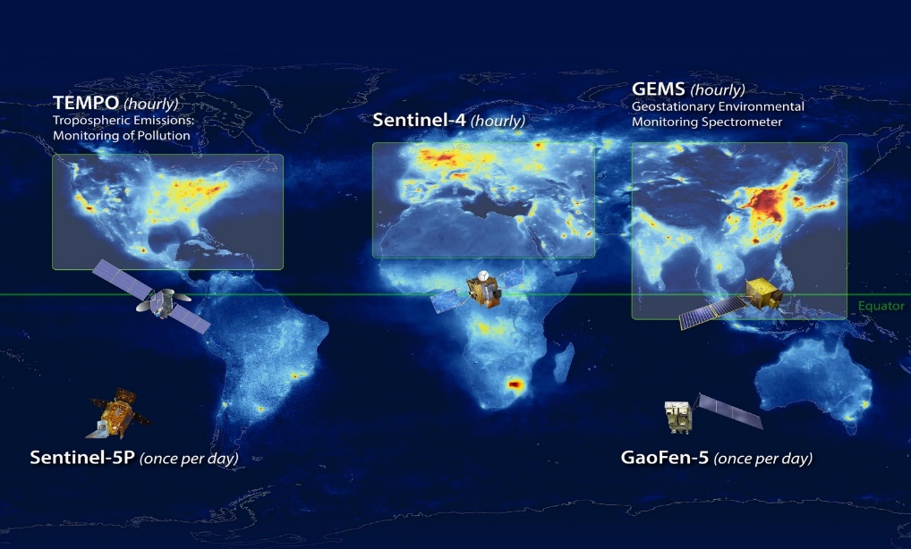
North American Component of An International Geostationary Air Quality Constellation
Launch ~March 2023
Launch early 2024
Launch Feb 2020
Image Credit: NASA LaRC

Slide 4
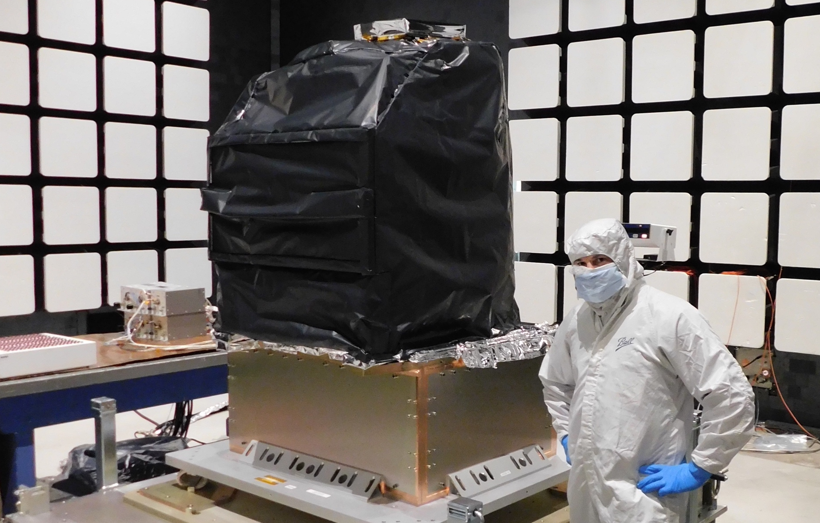
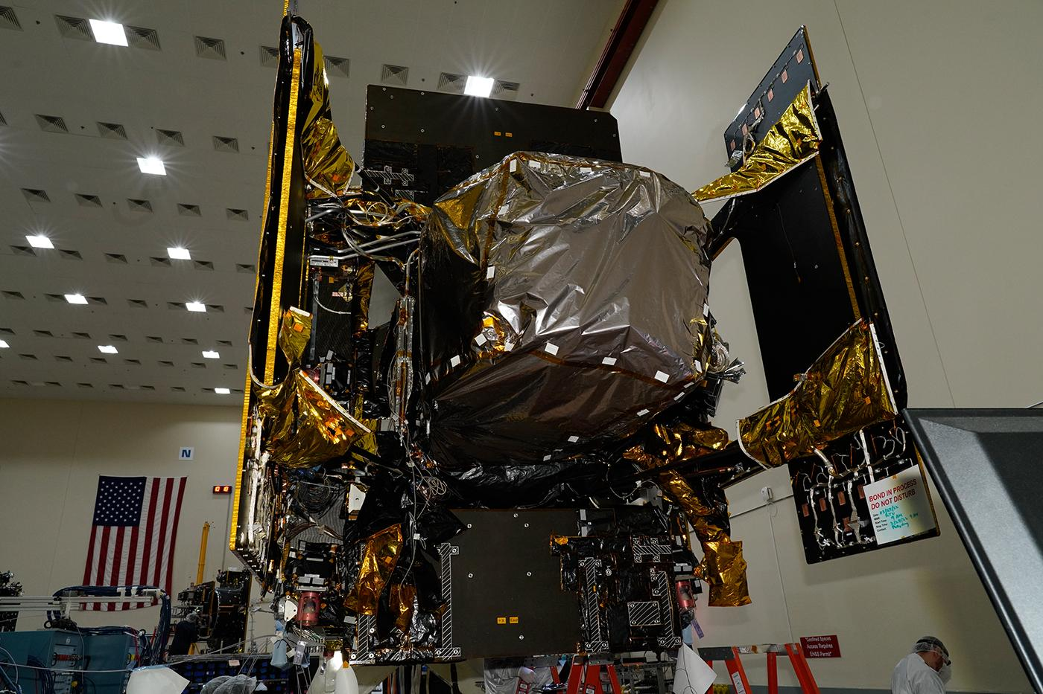
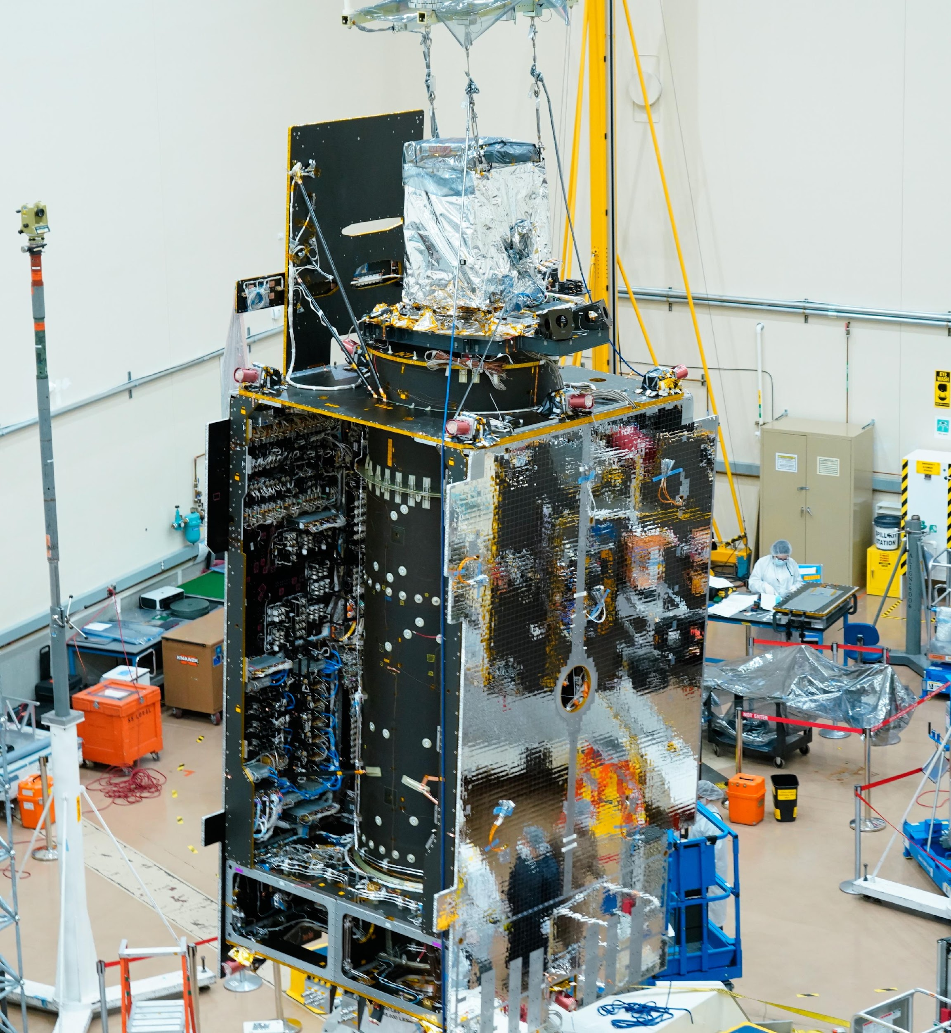
TEMPO Status
  Instrument delivery by Ball Aerospace in Nov. 2018
  Host satellite provider: Maxar selected in July 2019
  Host: Intelsat 40e selected in 02/2020.
  TEMPO sensor fully integrated onto IS-40e on 6/30/2022. SCTV completed.
  Operation/Mission Readiness Review (ORR/MRR) in Jan. 2022
  Launch on SpaceX Falcon 9 on 3/13/2023
Courtesy from Ball Aerospace
Crews recently completed the first fully integrated powered testing of TEMPO, instrument on Intelsat IS40e at Maxar Technologies' satellite manufacturing facility in Palo Alto, California.
Credits: Image courtesy of Maxar Technologies
Courtesy from Maxar

Slide 5

TEMPO Instrument
  Imaging grating spectrometer measuring solar backscattered Earth radiance
    2 channels (1 focal plane but with 2 2-D 2 k x 1k detectors ): ~293-494 + 538-741 nm
    ~0.6 nm FWHM, ~0.2 nm sampling
~293-494 nm
~538-741 nm
Examples of spectra based on GOME

Slide 6

TEMPO Operation
  Operate on geostationary communications satellite Intelsat 40e (IS40e) at 91 ∘ W
Nominal: Scan FOR in 1 hour with 10 granules
~ 2K N/S pixels x 1226 steps/hr, ~ 2.5 M pixels/hr, daily # spatial pixels ~TROPOMI
2 x 4.75 km² @center of FOR, from 8 km² at Mexico City to 21 km² at Canadian Tar Sands
Optimized scan: in the early morning and late afternoon, daylight portion of FOR, higher temporal resolution
High-time scan (up to 25%): selected portion of FOR at higher temporal resolution (e.g., <= 10 mins)
Field of regard is optimized to cover both Puerto Rico and Canadian tar sands.
S5p-TROPOMI NO2 product oversampled by Kang Sun.

Slide 7
Baseline and Threshold Products (Variables) & Requirements
Species/Products | Required Precision | Temporal Revisit*
0-2 km O₃ (Selected Scenes) Baseline only | 10 ppbv | 2 hour
Tropospheric O₃ | 10 ppbv | 1 hour
Total O₃ | 3% | 1 hour
Tropospheric NO₂ | 1.0 × 10¹⁵ molecules cm⁻² | 1 hour
Tropospheric H₂CO | 1.0 × 10¹⁶ molecules cm⁻² | 3 hour
Tropospheric SO₂ | 1.0 × 10¹⁶ molecules cm⁻² | 3 hour
Tropospheric C₂H₂O₂ | 4.0 × 10¹⁴ molecules cm⁻² | 3 hour
Aerosol Optical Depth | 0.10 | 1 hour
* # of hourly measurements to be averaged to achieve required precision
Mission duration: 20 months for baseline
Spatial resolution: < 60 km² for baseline (4 native pixels coadded)
Aerosols, SO₂, C₂H₂O₂ were removed from baseline products during KDPC
Cloud product (cloud fraction, cloud pressure): used in trace gas/aerosol retrievals

Slide 8
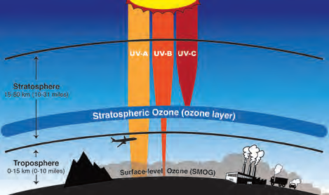
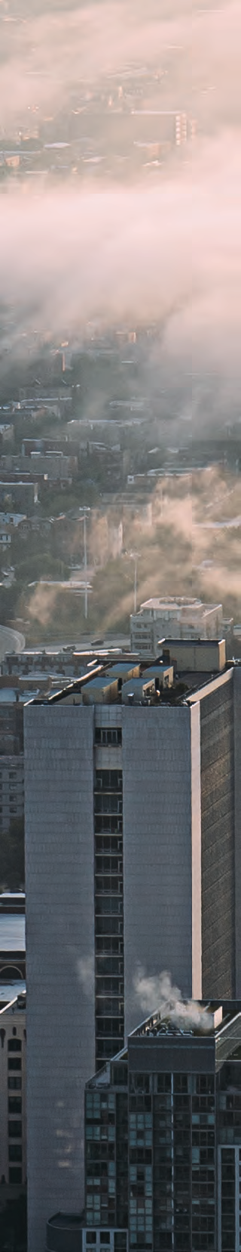

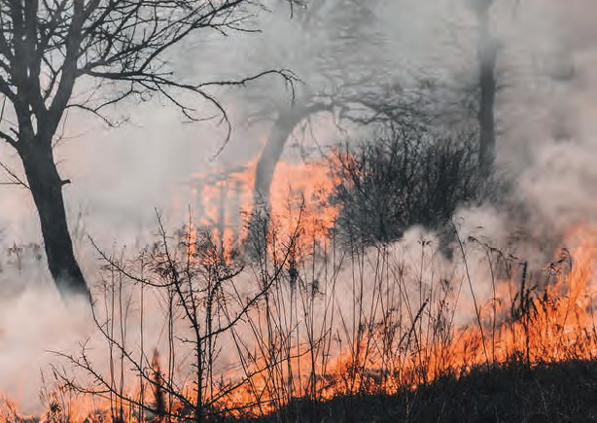



TEMPO Data Products
(Inc. Proposed NRT & Additional Products)
Level | Product | Algorithm | Major Outputs | Res km^{2 *} | Freq/Size
L0 | Digital counts | Raw to L0 | Reconstructed/reformatted digital counts | 2.0 x 4.75 | Daily/hourly
L1-b | Irradiance ^{NRT} | SAO L0-1 | Calibrated & quality flags |  | daily
 | Radiance ^{NRT} | SAO L0-1 | Geolocated,calibrated, viewing,geolocation&quality flags | 2.0 x 4.75 | Hourly, granule
L2 | Cloud ^{NRT} | OMI O2-O2 | Cloud fraction, cloud pressure | 2.0 x 4.75 | Hourly, granule
 | O₃ profile | SAO O3 profile | O3 profile, total/strat/trop/0-2 km O3 column, errors, a priori, AKs | <= 8.0 x 4.75** | Hourly, granule
 | Total O₃ | TOMS V8.5 | Total O3, AI, cloud fraction | 2.0 x 4.75 | Hourly, granule
 | NO₂ ^{NRT} | SAO trace gas, BU strat/trop sep. | SCD, strat./trop. VCD, error, shape factor, scattering weights | 2.0 x 4.75 | Hourly, granule
 | H₂CO ^{NRT} | SAO trace gas | SCD, VCD, error, shape factor, scattering weights | 2.0 x 4.75 | Hourly, granule
 | C₂H₂O₂ | SAO trace gas |  | 2.0 x 4.75 | Hourly, granule
 | H₂O | SAO trace gas |  | 2.0 x 4.75 | Hourly, granule
 | BrO | SAO trace gas |  | 2.0 x 4.75 | Hourly, granule
 | Aerosol ^{NRT} | OMAERUV+UI AOCH | AAI, UVAOD, UVSSA, AOCH, VISAOD | 8.0 x 4.75 | Hourly, granule
 | SO₂ | OMSO2 PCA | SCD, VCD (PBL,TRL,TRM,TRU,STL) | 2.0 x 4.75 | Hourly, granule
 | TEMPO/GOES-R Synerg. product | GOES-R products on TEMPO pixels | Radiance, aerosol, cloud & mask, fire/hotspot, snow/ice, rainfall, precipitable water, land/sea surface T, lightning | 2.0 x 4.75 | Hourly, granule
L3 | Gridded L2 | SAO L2-3 | Same as L2 | 2 x 2 (?) | Hourly, scan
L4 | UVB | GEMS/GSFC UVB | UV irradiance, erythemal irradiance, UVI | TBD | Hourly, scan
Black: launch-ready baseline products; green/orange/purple: additional products
Proposed NRT (L1b <~1 hr, L2 cloud <~1.5 hr, L2/3 trace gas < ~2.5 hrs): from SNWG, NASA+NOAA OMB, NOAA to produce aerosol NRT
NRT data products timeline, 4-5 months behind baseline products (1/2024 start NRT processing, 6/2024: public release)
* Spatial resolution at center of FOR. ** Might be at 8 x 9.5 km²

Slide 9
Algorithm Development
Algorithm Development Status & Plan
SDPC V3 (launch ready) completed in Feb. 2022
Algorithm mostly based on OMI heritage algorithms except for new L0-1b processor (including INR using GOES-R from Carr Astronautics)
Updates to L1-2 algorithms (O₃ profile, NO₂, HCHO, cloud, total O₃):
  Adapted for TEMPO in NetCDF-4 format
  Add visible to SAO UV O3 profile algorithm, SAO trace gas algorithm with adapted NASA strat/trop separation for NO2
  CLDO4^{new}: SAO O₂-O₂ fitting + GSFC’s O₂-O₂ cloud at ~477/466 nm (Huiqun Wang, Eun-Su Yang, Alexander Vasilkov)
  NASA GMAO’s GEOS-CF trace gas profiles and meteorology (Emma Knowland and GMAO)
  Hourly resolved monthly mean Geometry-dependent Lambertian Equivalent Reflectivity (GLER) climatology (Christopher Chan Miller, Wenhan Qin, Zachary Fasnacht)
Development of other products
  CHOCHO, H₂O, BrO: will use SAO’s trace gas algorithm
  SO₂: OMI PCA SO₂ algorithm adapted for TEMPO/GEMS from synthetic/GEMS data (Can Li)
  Aerosols: being adapted from OMI/TROPOMI AERUV algorithm (Omar’s team), from EPIC/TROPOMI Aerosol Layer Height algorithm using O₂-A/B (Jun Wang’s team)
Continue to make minor updates to improve beyond V3
  Further improvements using synthetic and GEMS data: destriping, radiance reference & background correction, cross section updates, empirical correction
  Algorithm refinement/optimization during commissioning (Jun-Sep 2023) and nominal operation

Slide 10
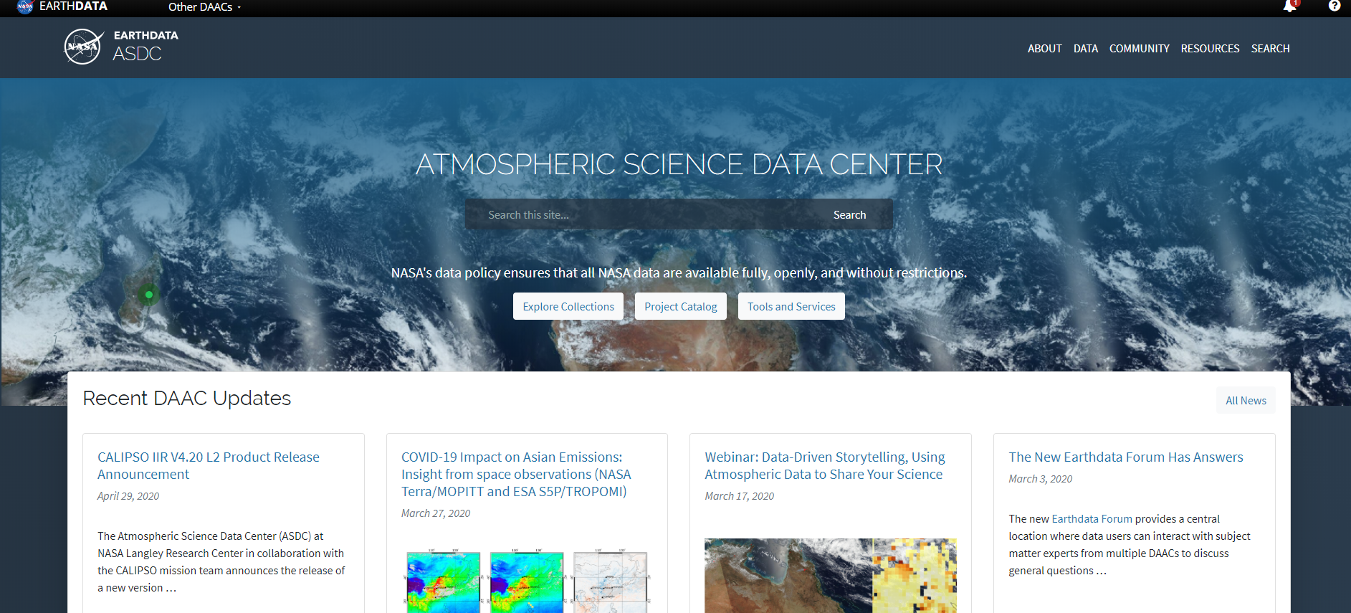




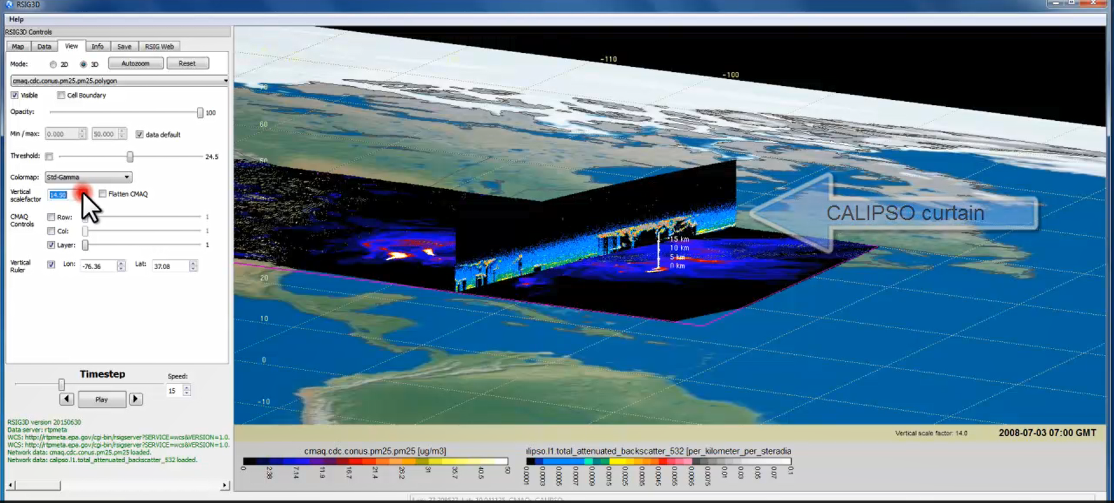
TEMPO Data Products Distribution
ASDC Data Archival & Distribution: Tools and Services
NASA Earthdata Search
  CMR Search ⚬ Metadata
NASA WorldView
  GIBS API ⚬ visualization
Harmony and OPeNDAP
  ⚬ transform ⚬ subsetting
  ⚬ reformatting ⚬ distribution
HTTPS data access
  ⚬ datapool
  ⚬ permanent URL/direct access
  ⚬ enables scripts/workflow
Geospatial Web Services
  ⚬ WCS ⚬ WMS ⚬ ArcGIS Image Service
Example scripts
  ⚬ Python/Jupyter Notebook
  ⚬ R scripts
  ⚬ contributed tutorials/scripts
EPA RSIG3D Gateway
TEMPO data can be served directly through the EPA RSIG. https://www.epa.gov/hesc/remote-sensing-information-gateway
User Support and Other Resources
Earthdata Login https://urs.earthdata.nasa.gov
Earthdata Forum https://forum.earthdata.nasa.gov/
ASDC User Support support-asdc@earthdata.nasa.gov
Slides from Jeff Walters, Tim Larson at TEMPO STM 2020 & EAWNov2021

Slide 11
Commissioning Timeline &
Data Release Plan
TEMPO
Power On
Launch
First Light
PLAR
L+0
L+88 days
L+120 days
L+178 days
Outgassing
S/C Activity
(TEMPO Off)
TEMPO Commissioning
Nominal Operations
Activation
Instrument Characterization and Analysis
*L+# days are approximate and will be refined as we finalize commissioning details
Activity | Intelsat
LEOP: Orbit Transfer | 2 Weeks
Spacecraft Bus IOT | 1 Week
Payload IOT | 4 Weeks
Drift to Location | 4 Weeks (TBD) 60º drift to 91ºW
Commercial Services (Onboarding Customers) | 1 Week
TEMPO Commissioning Begins | Expect L+12 Weeks
TEMPO commissioning: 06/15-9/15/2023, first light ~7/15/2023
Nominal operation after PLAR: ~9/15/2023
Plan for initial public release of baseline products at ASDC (L1b in ~4 mons, L2/3 in ~6 mons after PLAR): L1b, 1/2024; L2/3, 3/2024
Provide baseline data products to validation team priori to the public release via ASDC.

Slide 12
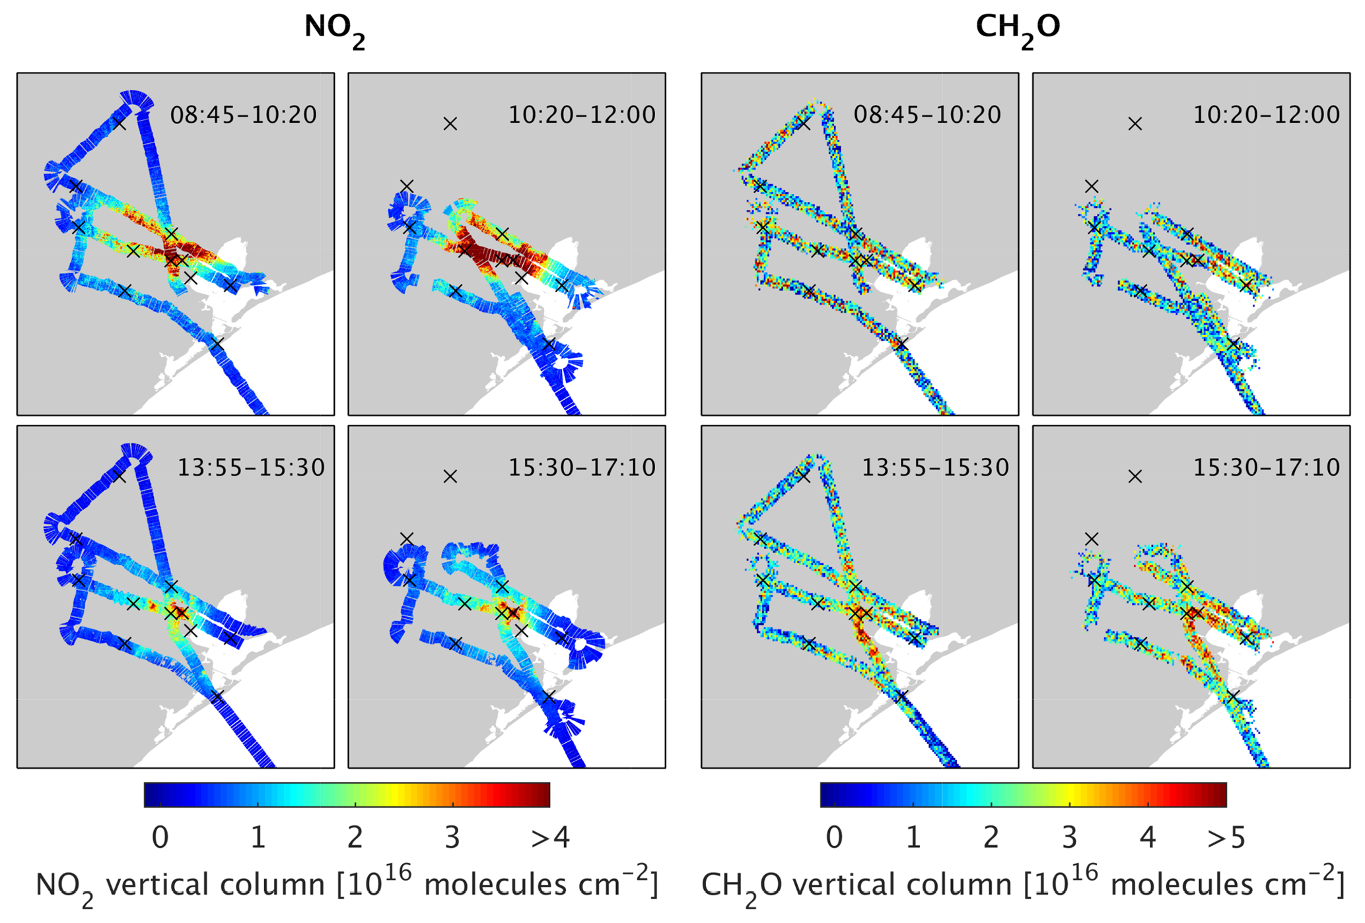
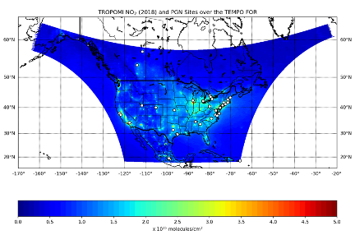
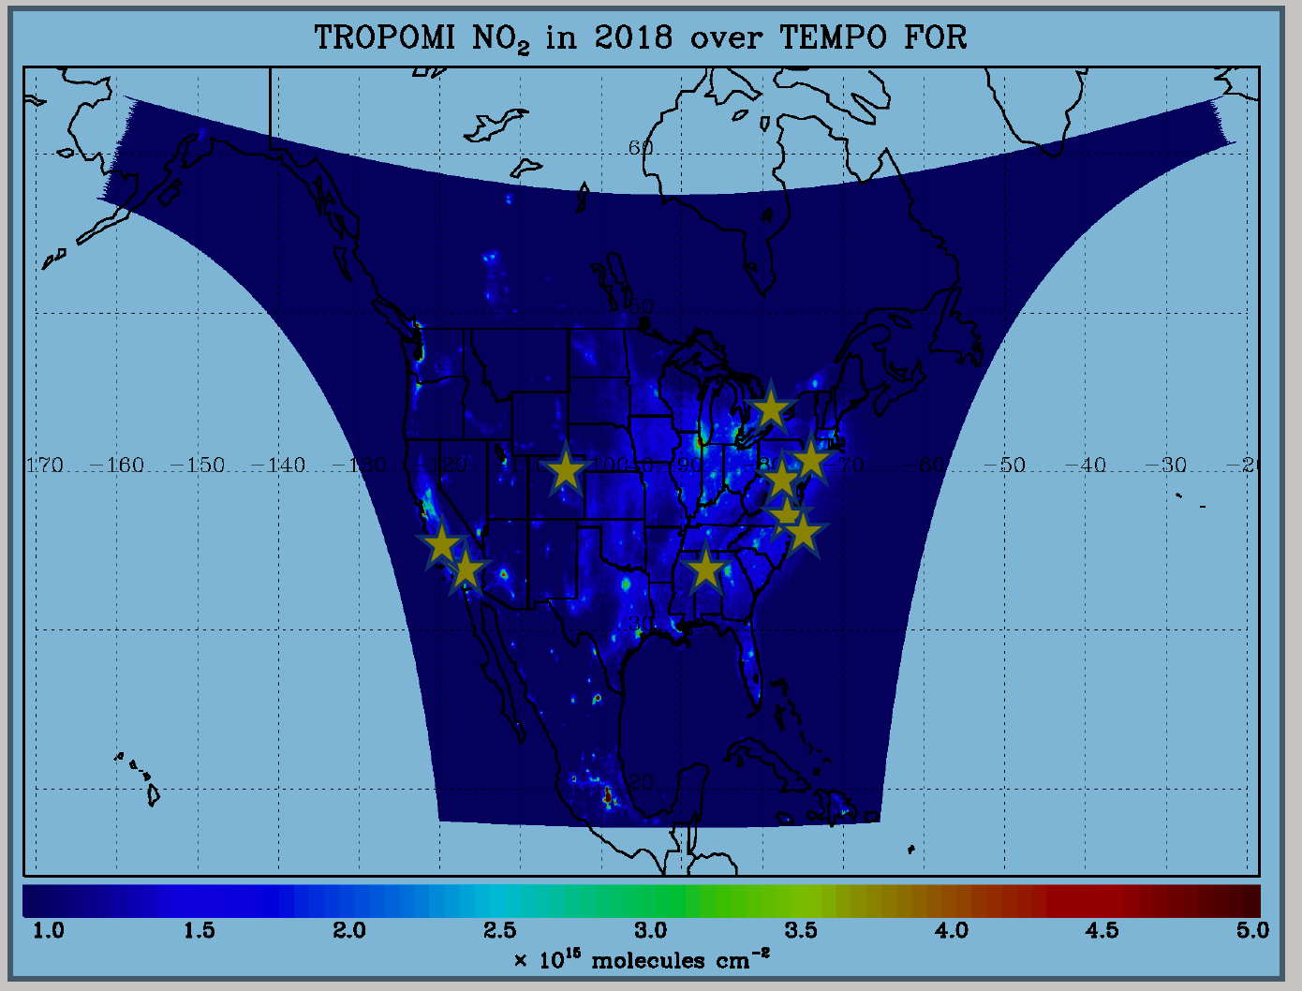
TEMPO Validation Plan
TEMPO PLRA has a bare minimum validation requirements (3 Pandoras, 1 month per season)
Jim Szykman is leading development of best-of-effort basis validation plan: beta, provisional, full
Use satellite observations (i.e., LEO and EPIC/DSCOVR) for cross validations
Pandora & Pandonia Global Network (PGN): validate NO₂, HCHO, total O₃ and diurnal variation
TOLNet: 8 LIDAR instruments by time of launch to validate tropospheric O₃ & 0-2 km O₃ and diurnal variation
https://www.pandonia-global-network.org/
www-air.larc.nasa.gov/missions/TOLNet/
Nowlan et al. (2018) GCAS, DISCOVER-AQ, Texas, Sep 2013
~60 PGNs in TEMPO FoR, ~20 to add in 2 years
Airborne instruments: GEO-TASO, GCAS, HSRL-2, SeaRey UAV
Other instruments: ozonesonde, MAXDOAS, FTIR, Dobson/Brewer, AERONET, …
Planned flight campaigns like STAQS, AEROMMA, GOTHAAM during June-Aug 2003, provide integrated approaches linking TEMPO Science, Applications, and Validation

Slide 13
TEMPO Green Paper:
Chemistry Experiments with TEMPO
Early Adopters are key to building the TEMPO Green Paper!
NORMAL TIME RESOLUTION STUDIES | Volcanoes
Air quality and health | Socio-economic studies
Ultraviolet exposure | National pollution inventories
Biomass burning | Regional and local transport of pollutants
Synergistic GOES-16/17 Products | Sea breeze studies for Florida and Cuba
Advanced aerosol products | Transboundary pollution gradients
Soil NO_{x} after fertilizer application and after rainfall | Transatlantic dust transport
Solar-induced fluorescence from chlorophyll | HIGH TIME RESOLUTION EXPERIMENTS
Foliage studies | Lightning NO_{x}
Mapping NO₂ and SO₂ dry deposition at high resolution | Morning and evening higher-frequency scans
Crop and forest damage from ground-level ozone | Dwell-time studies and temporal selection to improve detection limits
Halogen oxide studies in coastal and lake regions | Exploring the value of TEMPO in assessing pollution transport during upslope flows
Air pollution from oil and gas fields | Tidal effects on estuarine circulation and outflow plumes
Night light measurements resolving lighting type | Air quality responses to sudden changes in emissions
Ship tracks, drilling platform plumes, and other concentrated sources. | Cloud field correlation with pollution
Water vapor studies | Agricultural soil NO_{x} emissions and air quality
The TEMPO Green Paper living document at http://tempo.si.edu/publications.html
High-time special observations can be requested at:
https://weather.msfc.nasa.gov/tempo/green_paper.html

Slide 14









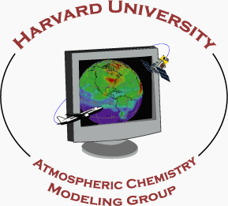



















We are on track to be ready for the TEMPO launch in March 2023.

Slide 15
Research Products
TEMPO research products will greatly extend science and applications
  OClO, IO, HNO₂, NO₃, volcanic (SO₂ plume height and VCD)
  Additional/improved cloud with O₂-O₂ bands / O₂-B bands
  Additional aerosol products from hyperspectral spectra, O₂-B and O₂-O₂-bands, and TEMPO + GOES-R synergy at @U Iowa, NOAA, GSFC
  Vegetation/Ocean Color products: vegetation indices, Growth Primary Productivity (GPP), Solar Induced fluorescence (SIF), ocean color
  Surface albedo/BRDF products
  Diurnal out-going shortwave radiation and cloud forcing
  Night lights: allows discrimination between lightning types
  Higher-level products: Near-real-time pollution/AQ indices

